Slide 1

BUDGET SUMMARY
PRESENTATION
Fiscal Year 2023
Driven by Employee Pride
Harold Ward, Cabinet Secretary

Slide 2


purpose
W. Va. Code § 22-1-1 (a)(1) – Restoring and Protecting the environment is fundamental to the health and welfare of individual citizens, and our government has a duty to provide and maintain a healthful environment for our citizens.
W. Va. Code § 22-1-1 (b)(4) - …to improve the quality of the environment…consistent with the benefits to be derived from strong agricultural, manufacturing, tourism and energy-producing industries…

Slide 3
Vision
A fully-protected and healthy environment where every West Virginian can live, work, prosper and enjoy a high quality of life.

Slide 4
Mission
To efficiently and effectively carry out the State's environmental laws and regulations that are designed to provide and maintain a healthful environment consistent with the economic benefits derived from strong agricultural, manufacturing, tourism and energy-producing industries.

Slide 5
CORE VALUES
Professionalism
Integrity
Education
Knowledge
Expertise
Credibility
Public Service

Slide 6
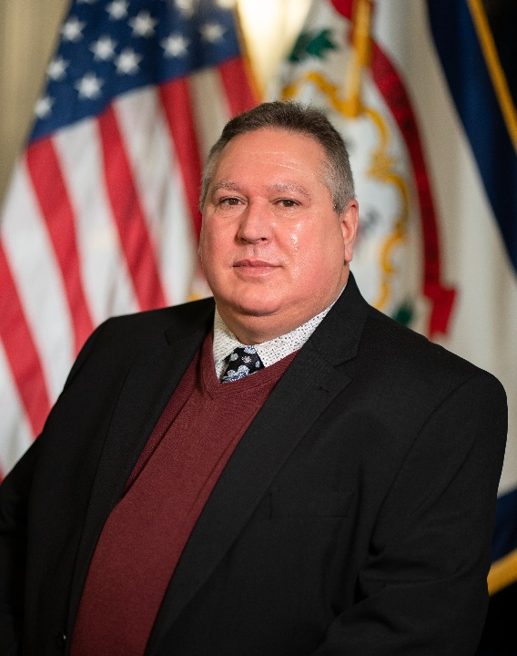

DEP organization
Harold Ward, Cabinet Secretary
Scott Mandirola, Deputy Cabinet Secretary
Notes:
Page 1 of Handout
Talk about Operations and Internal Affairs

Slide 7
Activities
Air Quality, Water Quality, Waste Management, Oil & Gas, and Mining
Permitting
Inspection
Enforcement
Remediation
Voluntary Compliance
Education & Outreach

Slide 8
Division of Air Quality
The Division of Air Quality (DAQ) protects the State’s air quality as follows…
Monitor, collect, analyze and summarize air quality data collected
Inspect and investigate air pollution sources
Address citizen complaints involving alleged air pollution violations
Inspect asbestos demolition and renovation projects
Process permit applications for major air emission facilities (Federal Clean Air Act)
Process source pre-construction permit applications for industry to build or expand operations
Develop and revise state implementation plans for National Ambient Air Quality Standards (enabling West Virginia to maintain federal funding)
Provide free confidential air quality assistance to small businesses (Small Business Assistance Program)

Slide 9
Division of Land Restoration
The Division of Land Restoration (DLR) restores the State’s environment by reclaiming former coal mining and industrial sites. The two offices of the Division of Land Restoration are Environmental Remediation and Environmental Reclamation. Environmental cleanup includes…
Remediation
  EPA’s Superfund
  Brownfields
  Voluntary Remediation
Reclamation
  Abandoned Mine Lands and Reclamation (AMLR) - restores and reclaims West Virginia’s land and water resources disturbed by surface mining operations prior to the passage of the federal Surface Mine Control and Reclamation Act of 1977. This office is funded 100% by federal dollars and conducts millions of dollars in reclamation work each year.
  Special Reclamation (SR) – Rehabilitation of lands which were subjected to permitted surface mining operations and abandoned after August 3, 1977.
  Landfill Closure and Assistance Program (LCAP) – Remediation of non-compliant and closed landfills as of December 31, 1994 to acceptable environmental standards.

Slide 10
Division of Mining and Reclamation
The Division of Mining and Reclamation (DMR) regulates the surface effects of all coal and non-coal mining activity under the West Virginia Surface Coal Mining and Reclamation Act and other applicable state laws and rules. One of the critical goals of the DMR is to ensure that the State’s program conforms to the federal Surface Mining Control and Reclamation Act, with oversight from the federal OSM. This is accomplished through…
Permitting
Inspection
Enforcement

Slide 11
Division of Water and Waste Management
The Division of Water and Waste Management’s (DWWM) mission is to preserve, protect, and enhance the state’s watersheds for the benefit and safety of all citizens. Regulated activities and efforts include the following:
Hazardous waste
Solid waste
Surface and groundwater pollution
Industrial, municipal and storm water discharges
Construction, operation, and closure of hazardous and solid waste facilities
Underground and above ground storage tank programs
Education, technical, and financial assistance
Comprehensive watershed assessments
Groundwater monitoring
Water quality standards implementation
Wetlands preservation
Permitting
Inspection
Enforcement
The Clean Water State Revolving Fund program is a funding program to address water quality problems through wastewater facility construction, upgrades, or expansions. The program is charged with general oversight, fiscal management, and administrative compliance review of local governmental entities that receive funds. To date, the program has granted more than $1 billion in loans to assist with construction and upgrades to these facilities.

Slide 12
Office of Oil and Gas
The Office of Oil and Gas protects the public health, environment, and other natural resources through the regulation of oil and gas resource development and the plugging and reclamation of abandoned oil and gas well sites.
Permitting
Inspection
Enforcement
Abandoned Well Plugging

Slide 13
Executive
The Executive Office includes the following units.
Administrative Support Offices
  Business Operations
  Integrated Regulatory Information Support (IRIS, which is the IT function for the DEP) - Expansion of E-permitting a top priority
  Human Resources Division
Homeland Security and Emergency Response for hazardous waste emergencies (HSER)
Environmental Advocate’s Office--the public’s main access to the DEP
  Youth Environmental Program
  Pollution Prevention and Open Dump
  Public participation in cleaning up roadside litter, streams, and open dumps
  Provide grants for general recycling, litter control, and electronic recycling.
Public Information Office (PIO)
Office of Legal Services (OLS)

Slide 14

Department of environmental protection
FINANCES
Money Management and Fiscal Responsibility
The DEP is careful to expend only necessary funds to execute its regulatory programs. The agency’s goal is to be more efficient and effective through its I.T. infrastructure and other means to meet the needs of a complex regulatory environment.

Slide 15
Investment Strategy, assuring funding for long-term liabilities
The agency takes very seriously its responsibility to ensure that unfunded environmental liabilities do not fall to future generations of West Virginians. The DEP is careful to build cash within its Special Revenue accounts to support ongoing environmental liabilities and provide funds for periods when industry activity and associated fees lag.
The Special Reclamation Funds, for instance, support reclamation of mining sites whose bonds were forfeited. The DEP has implemented investment strategies for these funds to ensure it maximizes returns without undue risk to the principle, increasing the availability of funds to meet these long-term liabilities.
Certainly, the past five fiscal years has seen phenomenal earnings in market securities. However, market adjustments are inevitable. This has never been more true than this agency’s activity in investments for fiscal year 2022 to date.
Investment Income
Amount | FY
3,243,689.95 | 2015
3,259,426.37 | 2016
17,745,357.15 | 2017
11,093,355.46 | 2018
19,411,519.99 | 2019
16,797,869.32 | 2020
47,974,318.99 | 2021
-630,249.66 | 2022 to date
The investments for DEP are managed by the West Virginia State Treasurer and the portfolio for our investments are considered a moderate risk.

Slide 16
FEES
The DEP collects various fees from the industries it regulates to support its programs. Traditionally, fees are based on estimated costs to run regulatory program(s) supported by the fee.
The Oil and Gas Operating and Permits Fund is supported by one time permit fees ($10,000/$5,000 for a horizontal well.) Currently this fee must support the regulatory oversight of these wells into perpetuity.
Likewise, in the mining industry, there are federally mandated inspection frequencies. Even idle or reclaimed mines must be inspected to protect from environmental hazards. With fee collections lower, the DEP must continue to carry out inspection activities.

Slide 17
DEP challenges - oog
The West Virginia Department of Environmental Protection’s Office of Oil and Gas (OOG) provides the regulatory and reclamation oversight for the state’s prospective, active, and abandoned oil and natural gas wells.
OOG’s operations are predominately funded through special revenue, largely a one-time permit application fee for well work. Decreases in industry permitting activity in FY 2019 and more dramatically in FY 2020, led to revenue shortfalls of approximately $250K and $800K respectively in those fiscal years. Consequently, while OOG undertook other measures to reduce expenditures and explore additional funding, we were faced with the need to decrease staff. The staff reduction process led to a departure of 14 OOG staff members and the reallocation of funding for a position to another division in DEP. Fortunately, due to continued expenditure decreases and a slight revenue increase, revenues exceeded expenditures in FY 2021 by approximately $150K.
It is recognized that this lower staffing level is not ideal for ensuring a desired level of performance. Consequently, OOG will be seeking a reliable and sustainable funding source for staff hiring to assist in serving our customers and meeting mandates for protecting the environment. OOG will be working with all stakeholders to develop a plan to obtain the funding necessary to maintain a viable and solvent oil and gas environmental regulatory program.

Slide 18
DEP challenges - DMR
The average coal tonnage fees (2 cents per clean ton mined) deposited into DMR’s Operations Fund for the past two years was approximately $1,398,935, a 25.6% decrease from fiscal year 2019. The amount of coal mined in tons is forecast to increase slightly in the next two years to approximately 80 million tons annually, then gradually decline to 73 million tons by 2025. Other coal mining related funds are experiencing similar decreases. Those funds consist of Fund 3301 Operator Permit Fees (WV SMCRA permit fees) and Fund 3490 Mountain Top Removal Fund (Explosive Material Fees).
MINE STATUS | STATUTORY INSPECTION FREQUENCY
Active | Every 30 days
Inactive | Quarterly
Abandoned | Annually

Slide 19
DMR:
The agency is directed by WV Code and applicable federal laws to regulate the environmental effects of the mining industry through continued inspection and enforcement activities.
West Virginia receives a federal grant through the Department of the Interior for these regulatory purposes, which requires a 50/50 state match. Although the program size has been adjusted in relation to market and regulatory conditions, future funding issues are expected to continue as revenues are anticipated to decline.

Slide 20
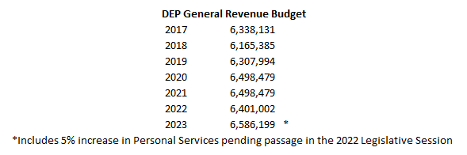
BUDGET
The budget of the DEP is predominantly Federal and Special Revenue, with approximately 1.19% ($6.5 Million) of funds appropriated from General Revenue.
Total budgets:
FY2021 $546,338,596
FY2022 $544,593,642
FY2023 $548,957,225*
Improvements
No improvements have been granted in the past two fiscal years for the agency.

Slide 21
FY 2023 Budget Includes 5% increase in Personal Services pending passage in the 2022 Legislative Session

Slide 22
EXPENDITURES
The Chart below shows the DEP’s expenditures from 2017 to date. Increases in expenditures have occurred as the Legislature has added new programs to DEP’s responsibilities, including the Aboveground Storage Tank Act in 2014.
The DEP also spends more when federal grants are higher. As noted below, awarding grants and performing reclamation remain the bulk of expenditures of the DEP. These activities inject over $100 million into the economy of West Virginia each year, with much of it being federal dollars. With the exemption of the DEP’s construction and reclamation contracts from review of the State Purchasing Division, reclamation activity has become more efficient, resulting in the issuance of more reclamation contracts this fiscal year, especially in the Special Reclamation and Abandoned Mine Lands Programs.

Slide 23
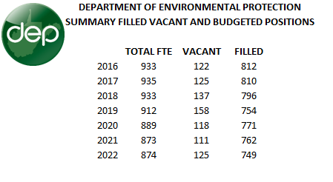
EMPLOYMENT
The agency strives to staff the organization to the needs of its regulatory requirements. As the needs of the regulated community fluctuate, the agency is constantly adjusting. Filled FTEs have been relatively static, even as the DEP has expanded some programs to meet additional regulatory requirements.

Slide 24
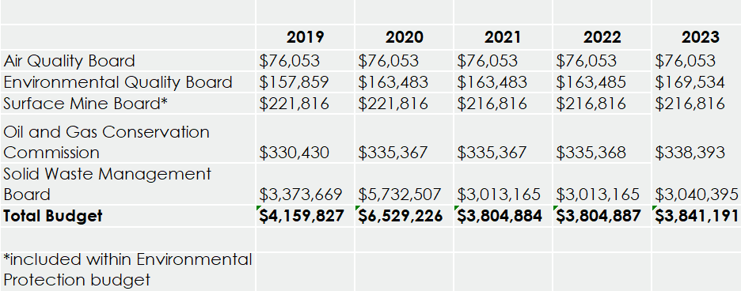
Boards and commissions budgets
FY 2023 Budget Includes 5% increase in Personal Services pending passage in the 2022 Legislative Session

